Slide 1
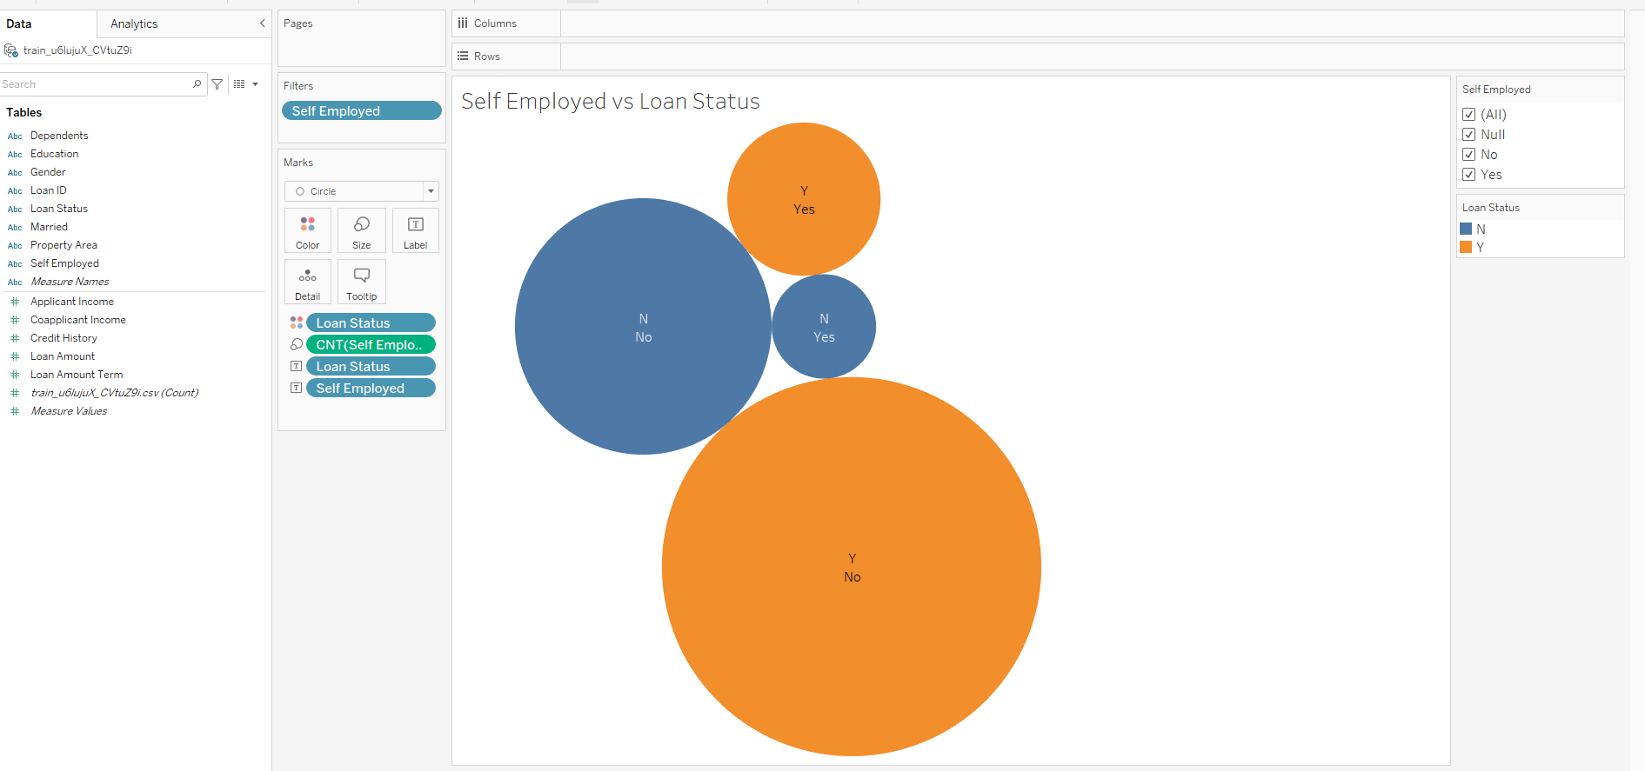
Blueprint of Dashboard
Individual Worksheets created in Tableau (sample of one of the worksheets seen below)

Slide 2
Blueprint of Dashboard
Individual Workbooks created in Tableau

Slide 3
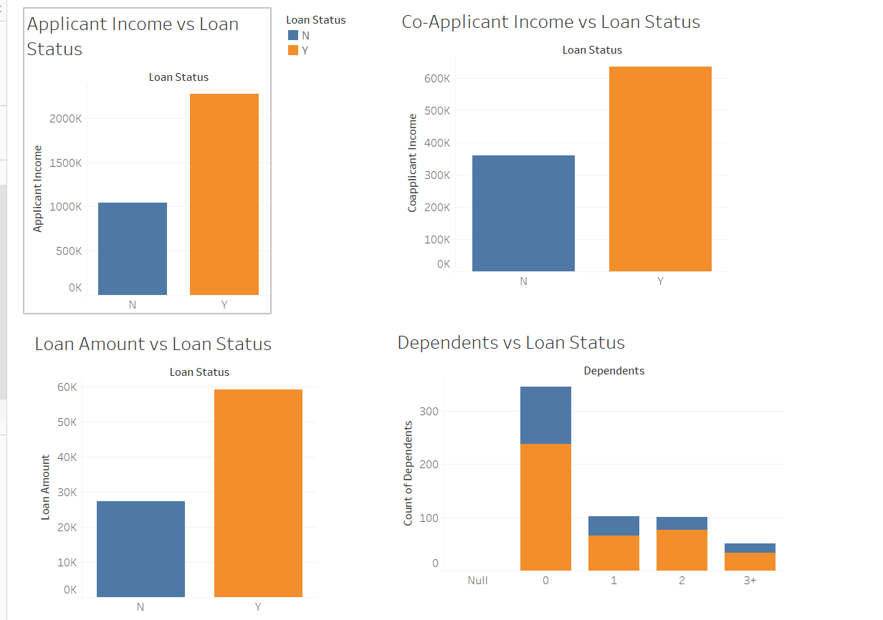
Blueprint of Dashboard
Three Dashboards created in Tableau (Sample as seen below)

Slide 4
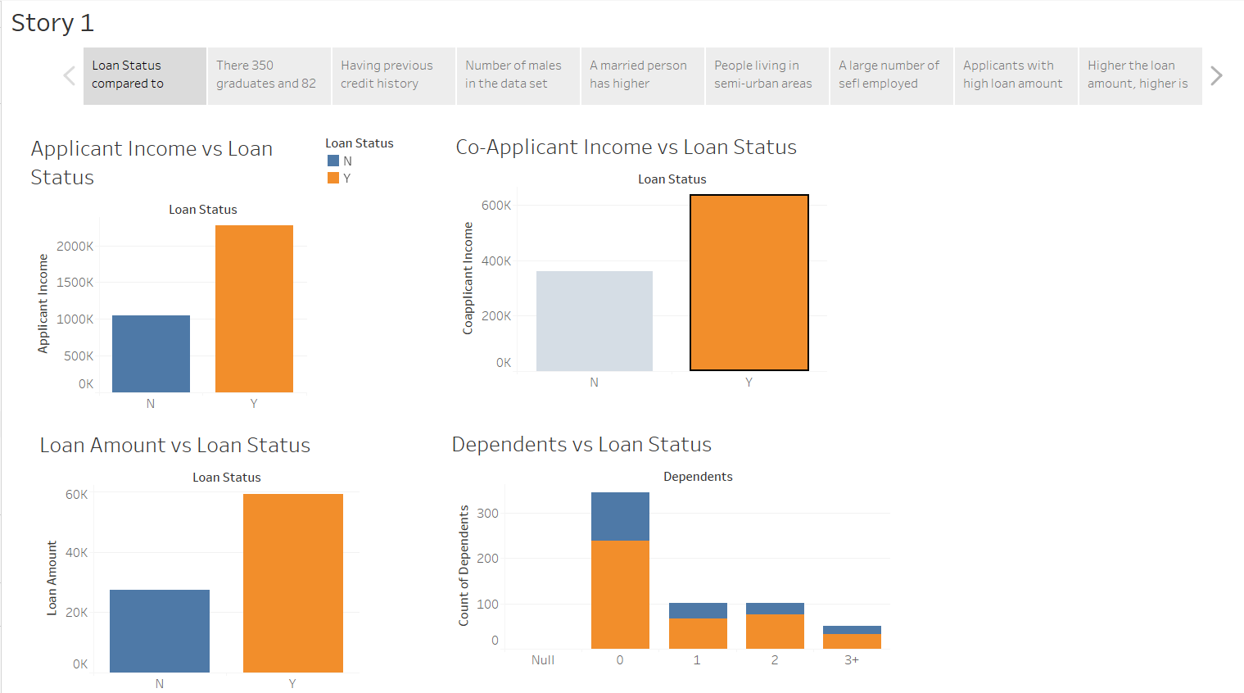
Blueprint of Dashboard
Final Story board with different analysis created in Tableau (Sample as seen below)

